Slide 1
BEAST attack: exploits predictable CBC IV in TLS v1.0

Slide 2
CBC for multiple msg (same K)
IV-1
m1[0]
m1[1]
m1[2]
m1[3]
⊕
⊕
⊕
⊕
PRP
PRP
PRP
PRP
K
K
K
K
IV-1
c1[0]
c1[1]
c1[2]
c1[3]
Necessary condition: IV must differ, otherwise insecure, again! (same msg → same ciphertext)
But different IV is NOT sufficient: IV must also be UNPREDICTABLE
IV-2
m2[0]
m2[1]
m2[2]
M2[3]
⊕
⊕
⊕
⊕
PRP
PRP
PRP
PRP
K
K
K
K
IV-2
c2[0]
c2[1]
c2[2]
c2[3]

Slide 3
What if predictable IV?
XXX = JOE or UGO
m[i-1]
PASS=XXX
m[i+1]
⊕
⊕
⊕
PRP
PRP
PRP
K
K
K
c[i-1]=FF54B1F1
c[i]=132FA776
c[i+1]
Attacker knows m[i] contains password
And guess this is either UGO or JOE, but does not know which
Attacker sees relevant ciphertext
But cannot learn which among the two passwd is encrypted (semantic security)
BUT attacker can convict the implementation to encrypt some data of his choice (Chosen plaintext attack): can he learn which passwd was used among the two choices?

Slide 4
What if predictable IV?
X predictable!
Chosen by attacker
IV = X
newmsg[0]
newmsg[1]
⊕
⊕
PRP
PRP
K
K
newct[0]
newct[1]
Attacker predicts X
Sets newmsg[0] = X⊕c[i-1]⊕PWGUESS
Example: X⊕”FF54B1F1”⊕”PASS=UGO”
If newct[0] == c[i] then guess OK!!
Aftermath: predictable IV → can mount a dictionary attack (initially prevented by semantic security)!

Slide 5
What if predictable IV?
Collected data, including target password
Chosen plaintext attack
X ⊕“FF54B1F1”⊕“PASS=UGO”
PASS=XXX
IV = X
newmsg[0]
⊕
⊕
“FF54B1F1”⊕“PASS=UGO”
PRP
PRP
PRP
K
K
K
c[i-1]=FF54B1F1
c[i]=132FA776
newct[0]
C[i]=ENC(K, “FF54B1F1”⊕“PASS=XXX”)
newct[0]=ENC(K, “FF54B1F1”⊕“PASS=UGO”)
If equal to c[i], then guess right!!
If different from c[i], then other pw right!!

Slide 6
Exploited in TLS!
Predictable IV: well known vulnerability
Rogaway 1999 (on IPsec issues)
Moller 2004 (explicitly addressing TLS)
TLS 1.0: IV of new msg = last c[i] of previous message
Corrected in TLS v1.1+
Explicit IV per new msg
Note that this is mandatory for DTLS
reception of previous msg not guaranteed
Not practical (?)
Limited interest so far in deploying TLS1.1+
Vulnerability theoretical, attack apparently hard to mount
…until september 2011: BEAST (T. Duong & J. Rizzo)

Slide 7
Why attack believed to be unpractical
Software issues
Chosen Plaintext Attach is active
Active agent code running on user browser
Injection of chosen plaintext from attacker
Found feasible with modern web technologies
Websockets, HTML5

Slide 8
Why attack believed to be unpractical
Complexity issues
Brute force attack: must provide a guess for all possible content of a block
AES: 128 bits block → 2¹²⁸ guesses → no way
Authentication cookies may be long!!
Complexity of guess exponential with authentication cookie size
Frequently auth cookies look very much «entropic», hard to dictionary attack
Turned out NOT to be the case!
Breakthrough enabler: «chosen boundary attack»!!
Attack LINEAR (!) with authentication cookie size!!

Slide 9
Chosen Boundary attack
B L A H . B L A H . . P A S S W D = A L I C E % 0 1
AES Block «border» not aligned to our field of interest
And in general authentication token not inside a single block
X X X X X B L A H . B L A H . . P A S S W D = A L I C E % 0 1
Insert preamble text (controlled by attacker)
Align authentication token so that ONLY FIRST CHARACTER is in block!!
And read relevant ciphertext

Slide 10
Chosen Boundary attack
P A S S W D = A L I C E % 0 1
Now perform attack:
256 guesses at most!
Less if base64 or if letters/numbers used, only
A S S W D = A L I C E % 0 1
Once first character found, re-aling block and perform attack:
256 guesses at most, again!
Complexity for N bytes cookie = 256*N e.g. 8 bytes passwd: 256*8 = 2¹¹ = 2048
Versus direct guess = 256^{N} e.g. 8 bytes passwd: 256⁸ = 2⁶⁴ =
⁼ 18.446.744.073.709.551.616

Slide 11
See Duong-Rizzo demo on Youtube
http://www.youtube.com/watch?v=BTqAIDVUvrU

Slide 12
CRIME attack: compression leaks (USABLE) information!

Slide 13
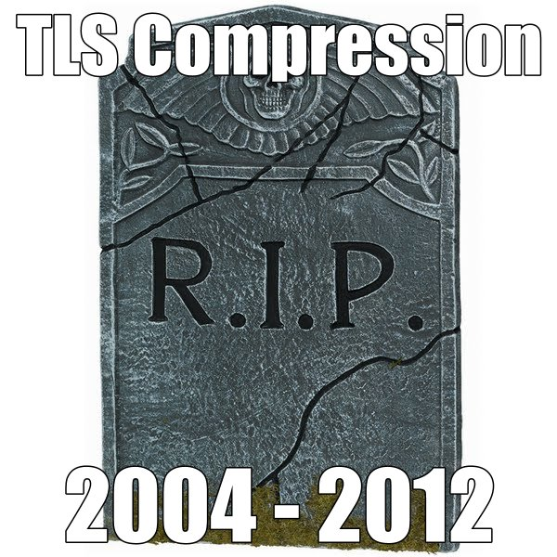
TLS Compression is harmful
Compression disabled in Chrome after september 2012 CRIME attack
Actually, more general than TSL: similar attack in other settings
TIME – Timing Info-leaks Made Easy
BREACH - Browser Reconnaissance and Exﬁltration via Adaptive Compression of Hypertext
Extends attack to HTTP compression
Not a problem of TLS, but a more general problem!
Actually, potential vulnerability known since 2002, but disregared for 10 years
Kelsey, Compression and Information Leakage of Plaintext
Source: T. Duong, J. Rizzo

Slide 14
Compression leaks size information
AAAABC
compress
4ABC
encrypt
X&%$
Size = 4 bytes
ABCDEF
compress
ABCDEF
encrypt
&$£A£$
Size = 6 bytes

Slide 15
Combining compression with Plain text injection – concept idea
Your data, unknown to attacker
SHARON
But attacker can see size of
Compressed+encrypted data
xxxxxx
SHARON
Attacker can repeatedly inject chosen plaintext prior to your data, and SEE size of
encrypted + compressed result
Compress+encrypt
xxxxxxxx
AAA[unknown]
BBB[unknown]
SSS[unknown]
3ASHARON
3BSHARON
xxxxxxxx
xxxxxxx
4SHARON
What’s the first letter of your data? Pretty easy, isn’t it? ☺

Slide 16
Attack made practical
CRIME = Compression Ratio Info-leak Made Easy
Duong and Rizzo, again, september 2012
Works IRRESPECTIVE of cipher!!
Practical enablers
Injection of chosen text prior to user data
Reusing BEAST software tools
Suitably chosen injected text
Relates to compression method details
Practically done for DEFLATE, in principle can be extended to other compression methods
Some extra tech details (skipped)

Slide 17
Attack details (simplified)
Attack relies on DEFLATE details
DEFLATE (jointly) uses two sub-algorithms
Huffman coding
we don’t discuss it, to keep simple
LZ77: replaces repeated 3+ char strings with (offset,size) pointers
GIUSEPPE BIANCHI AND MARCO BIANCHINI 36B
GIUSEPPE BIANCHI AND MARCO (-18,7)NI 31B

Slide 18
Attacker injects chosen text
Legitimate user text:
known header + unknown secret
e.g. authentication token: passwd=alice%01
Message crafted by attacker
Att_input + [header + secret]
Repeater many times
Attacker sees
Len(encrypt(compress(att_input+header+secret)))

Slide 19
How to chose input
GET /comment:twid=a HTTP/1.1 Cookie: twid=flavia\r\n
GET /comment:twid=a HTTP/1.1 Cookie: (-24,5)flavia\r\n
Repeat guesses… until
GET /comment:twid=f HTTP/1.1 Cookie: twid=flavia\r\n
GET /comment:twid=f HTTP/1.1 Cookie: (-24,6)lavia\r\n
1 byte shorter!!
And now start guessing second character as well!!
GET /comment:twid=fa HTTP/1.1 Cookie: twid=flavia\r\n
GET /comment:twid=fa HTTP/1.1 Cookie: (-24,6)lavia\r\n
GET /comment:twid=fl HTTP/1.1 Cookie: twid=flavia\r\n
GET /comment:twid=fl HTTP/1.1 Cookie: (-24,7)avia\r\n
And so on, linearly with secret size (again!)

Slide 20
A bit more complex than this, but… enough to sketch the idea
Compression works in bits, not bytes
With huffman coding as well
Must be careful to get at least a byte difference
Done on two protocols
TLS
SDPY (http2.0 candidate)
Some technical differences
TLS: includes a further chosen boundary attack
Very different boundary: TLS fragment (versus AES block in crime)
SPDY: must handle compression state over multiple requests
Uses compression dictionary window
Several optimizations to make the attack faster
Less guesses
compression size separately computed by attacker
More details @ http://www.ekoparty.org//archive/2012/CRIME_ekoparty2012.pdf

